Slide 1

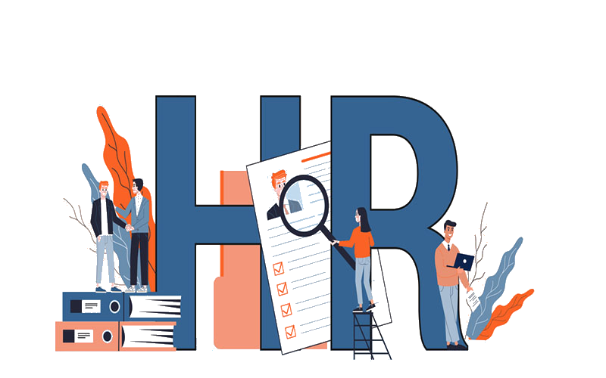
Analyzing recruitment trends on LinkedIn to provide human resource solutions for businesses
Nguyen Hoang Phuong
30/08/2024

Slide 2


OUTLINE
Introduction
Datasets
Results
Visualization – Charts
Findings & Implications
Discussion
Solution
Typical Talent Approach - Challenges
Adaptive Hiring
Example: Tetra Pak
Vietnam Adaptive Hiring Trend
Talent Acquisition
Talent “Focused”
A place to grow career
D.E.I
VNG Corporation – The ‘greatest’ place to work
Appendix
Executive Summary

Slide 3

INTRODUCTION
The analysis focuses on three major banking and finance companies: Bank of America, Deloitte, and Vietcombank. All three companies are part of the Big Four group within their respective regions.
The results are based on data from more than 5,000 employees across these companies, whose LinkedIn profiles were publicly available.
The analysis aims to identify IT staff shortages at Vietcombank compared to other companies and provide strategic solutions for Vietcombank in terms of talent acquisition and building a robust IT workforce.
Refer to articles from Gartner, Seek, etc., to explore potential solutions.
Analyze recent LinkedIn job postings by searching for the keyword ‘Finance.’”

Slide 4
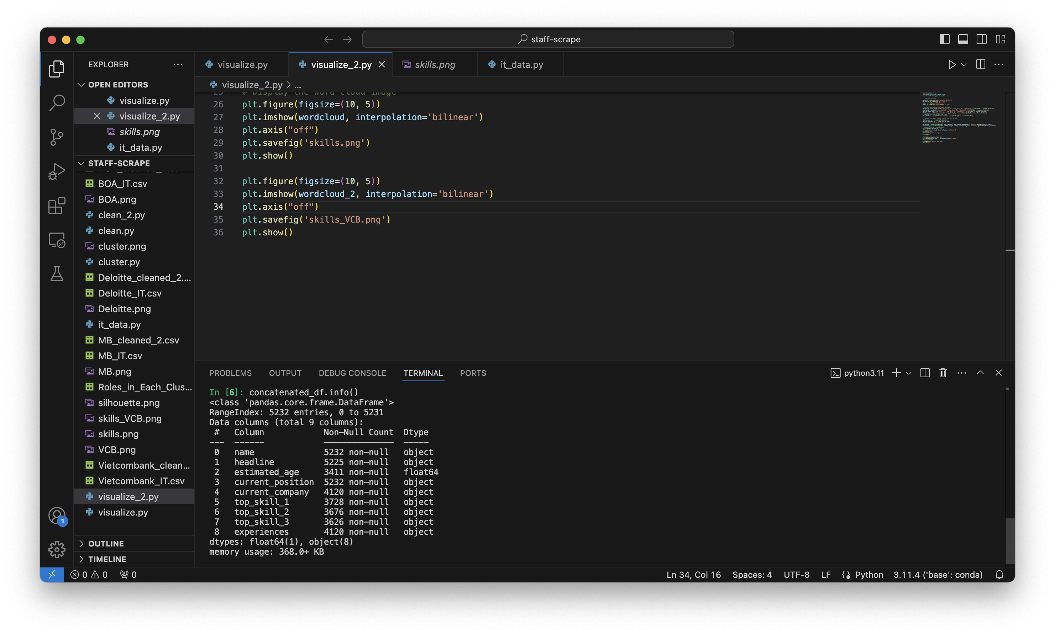
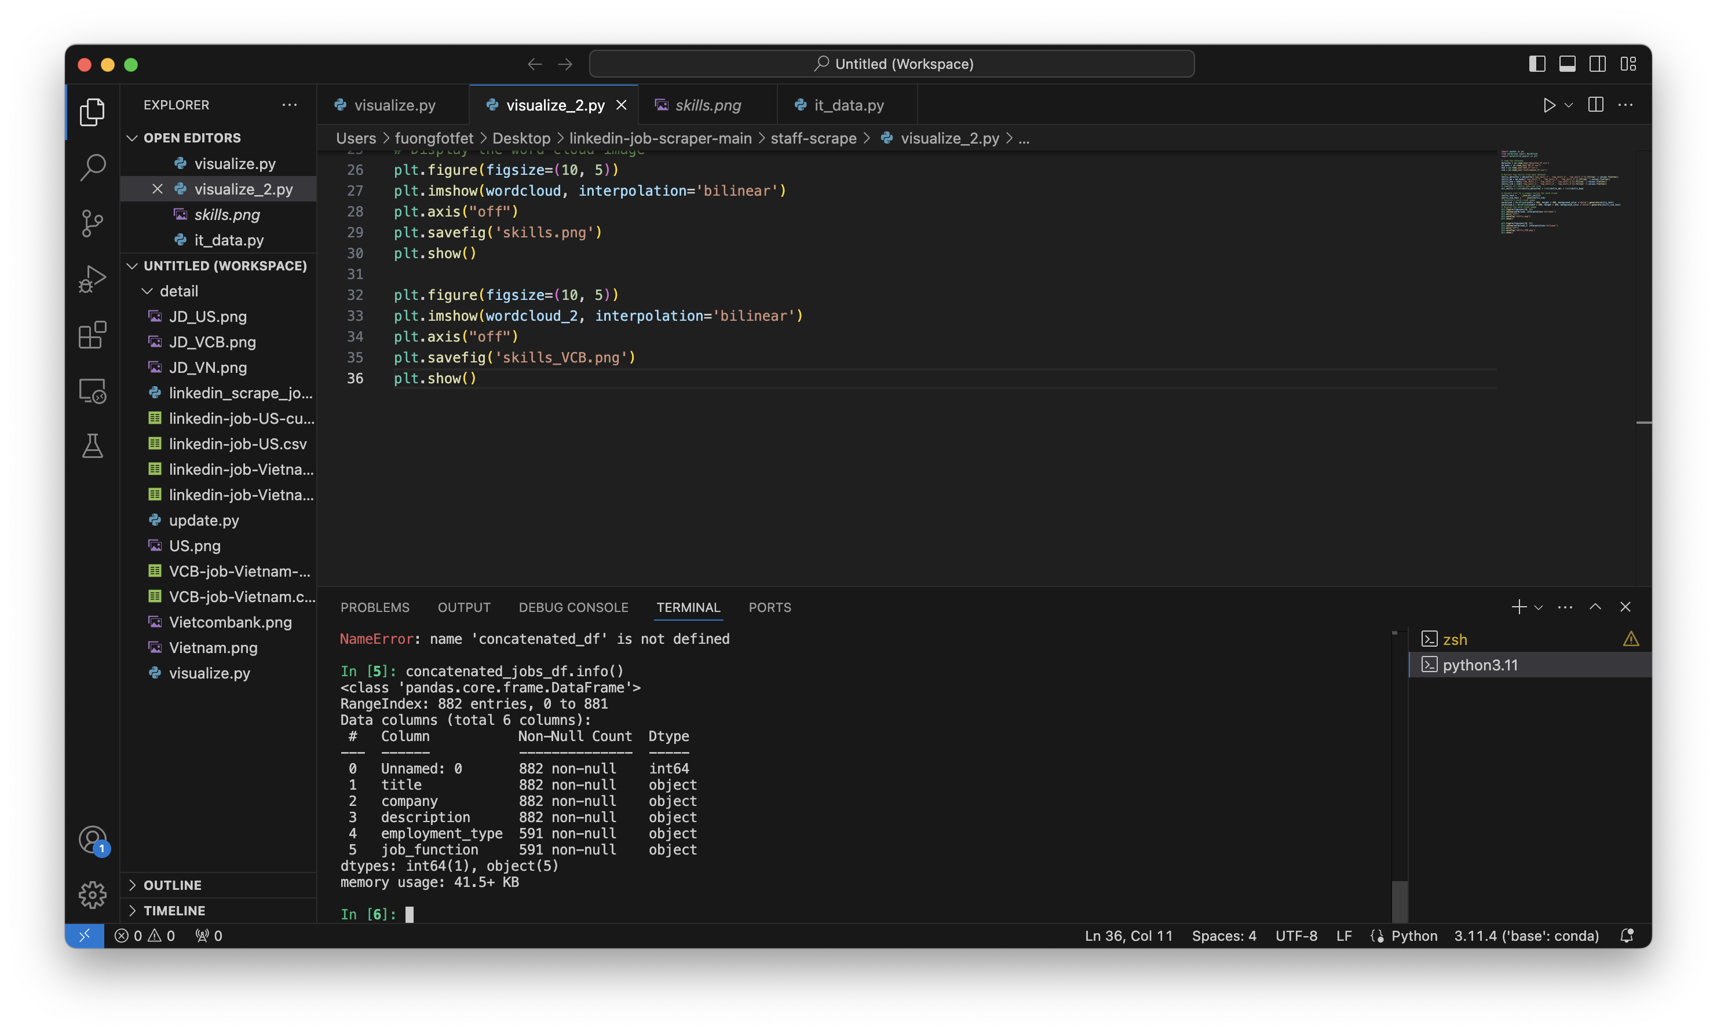
DATASETS
Data Source: All data extracted from LinkedIn.
Company Staff Datasets: Utilize Staffspy, a GitHub library, to gather data on each company.
Job Postings Datasets: Employ Selenium to interact with job postings by searching the keyword “Finance” in the US and Vietnam, and the keyword “Vietcombank.” Data scraping involves extracting relevant HTML tags.
Data Structure:
Company Staffs Datasets
name
headline (staff’s short description)
estimated_age
current_postion
current_company
top_skill_1,2,3
experiences
Job Postings Datasets
title
company
description
employment_type
job_function

Slide 5
RESULTS

Slide 6
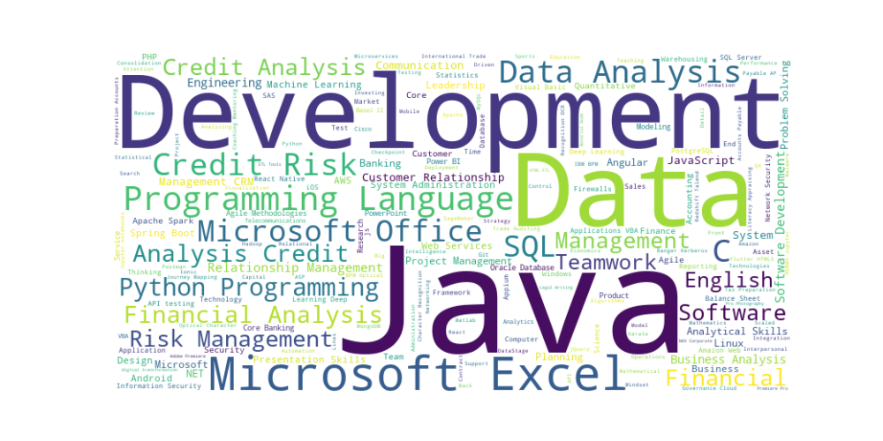
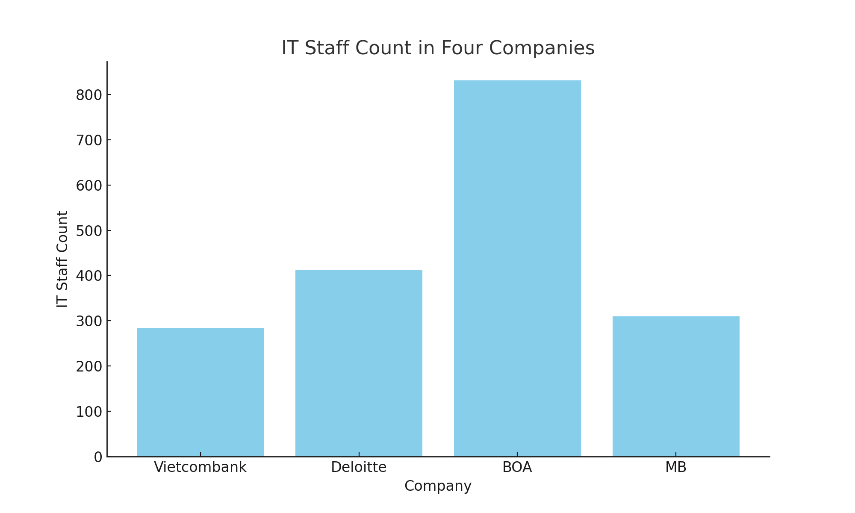
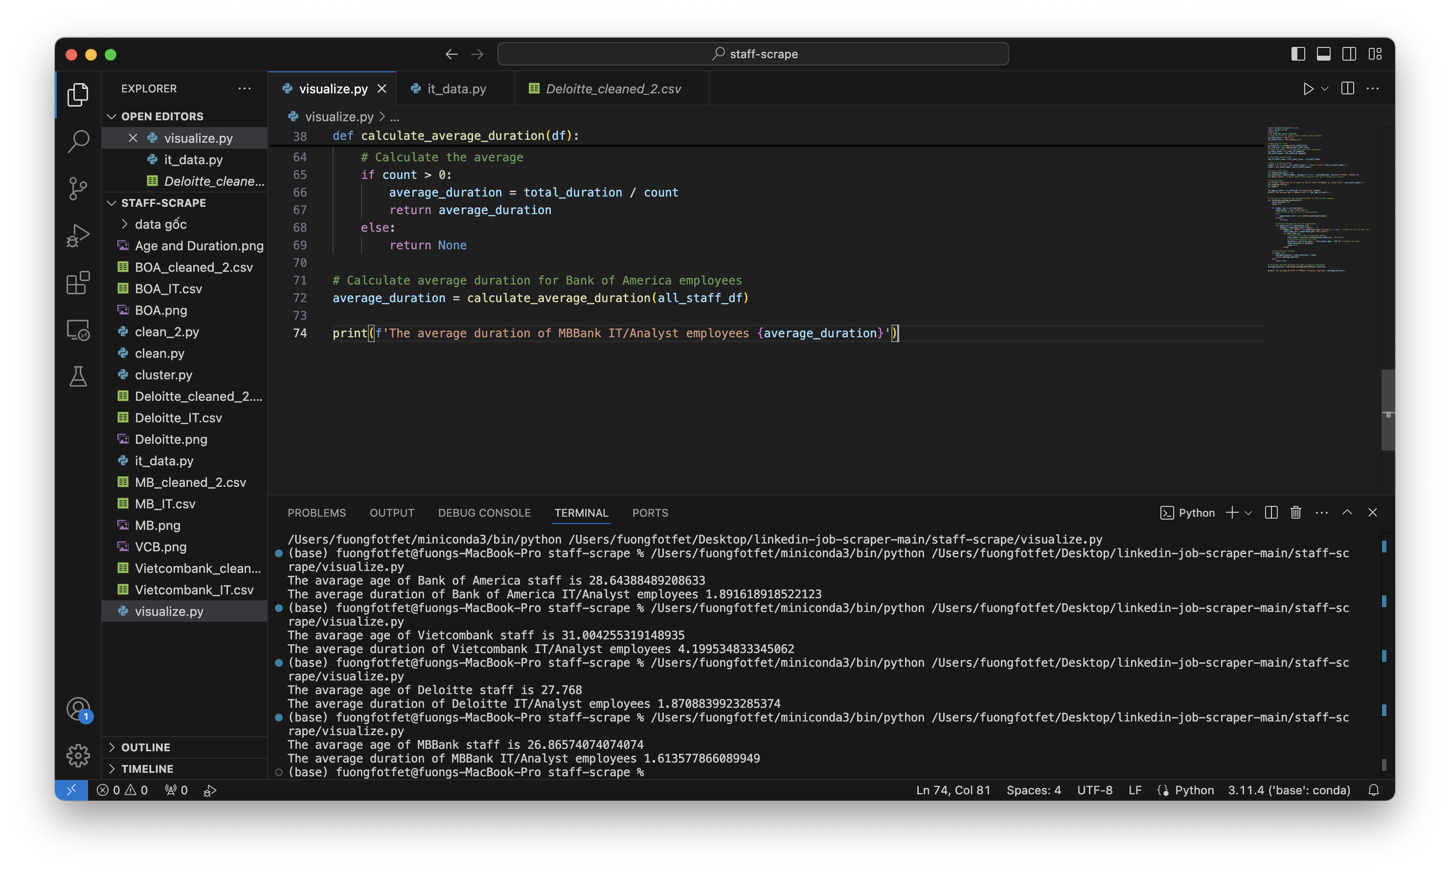
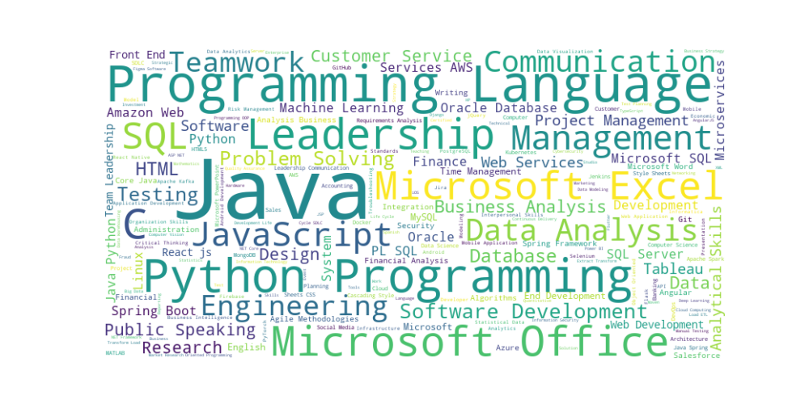
IT STAFFS COMPARISION
Vietcombank has the smallest IT workforce among the four companies
Vietcombank has the highest
average age of IT staffs (31)
Vietcombank’s skill range (above) is not as diverse as the other companies (below)
Vietcombank may be experiencing a shortage of IT staff, which is a concern in the current Fintech era.

Slide 7
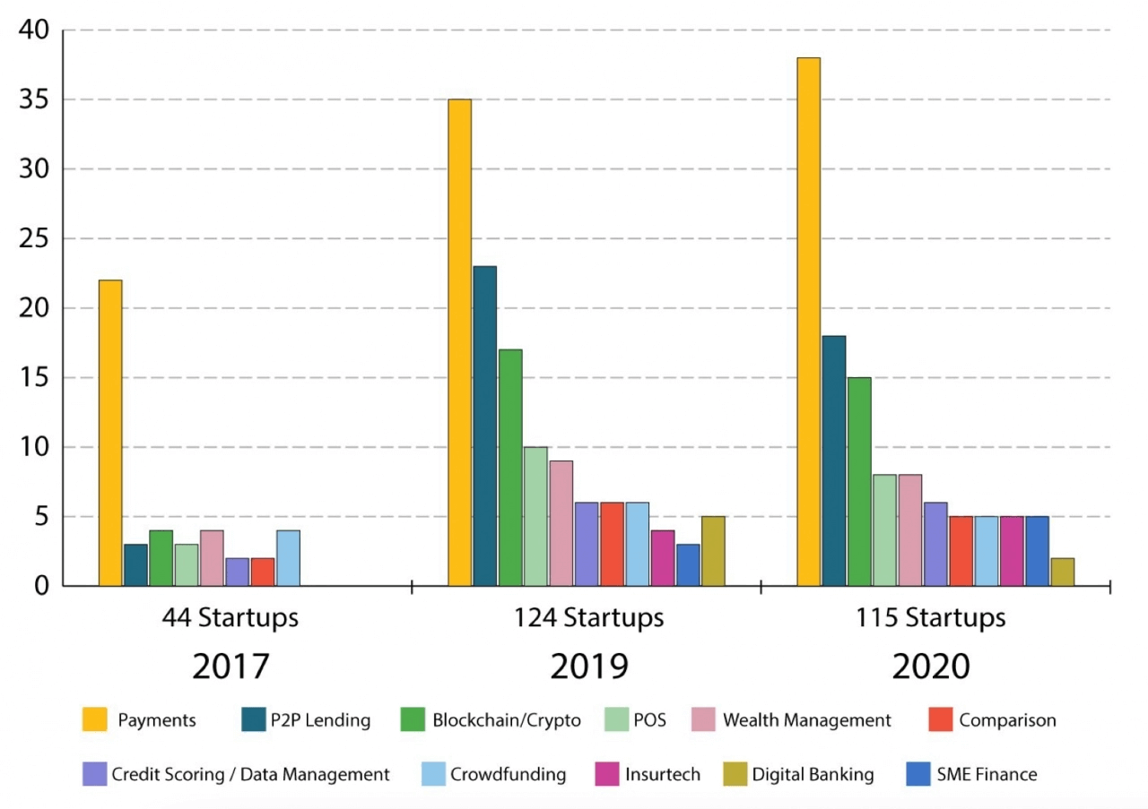
DISCUSSION
IT staff are becoming an essential component for the development of all sectors.
Specifically, in the banking industry, Fintech is emerging as a strong growth trend in Vietnam.
The shortage of IT personnel at Vietcombank will be a significant challenge in their digital transformation efforts.
Source: Finn
“The banking industry is going through a period of rapid change to meet competition, challenges of technology and the demand of end user. Clearly technology is a key differentiator in the performance of banks. Banks need to look at innovation not just for product but for process also.”
- ROLE OF IT IN BANKING SECTOR & CHALLENGES - Indian Journal of Economics & Business, Vol. 17, No. 3 (2018): 41-53
An enormous growth of startups and Fintech services in Vietnam

Slide 8

SOLUTION
HR needs a solution to address the IT staffing shortage at Vietcombank.
A comprehensive recruitment strategy is required to attract top talent.
Revise the company culture and rules to enhance talent acquisition.
Identify the necessary roles and skills to refine the job descriptions.

Slide 9
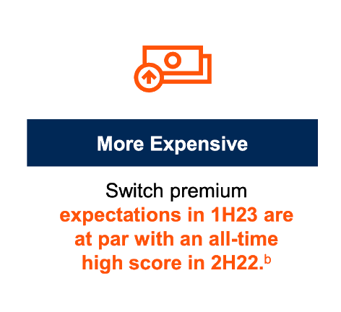
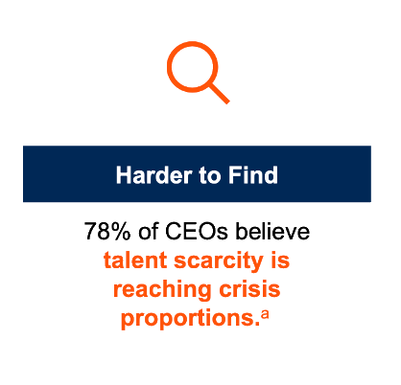
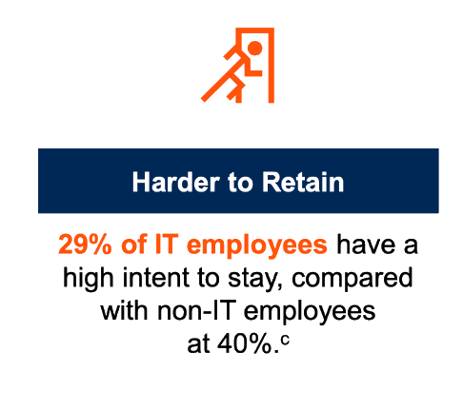
IT STAFFS CHALLENGES
Today's Triple Talent Squeeze
“Everyone is competing for the same talent. We’re increasing salaries and offering flexible work options, but even the most engaged employees are open to better offer elsewhere.
- CIO, Financial Service, Gartner

Slide 10
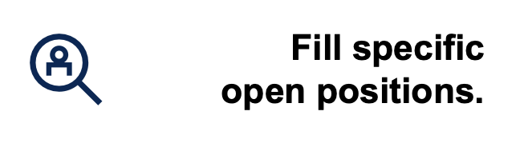

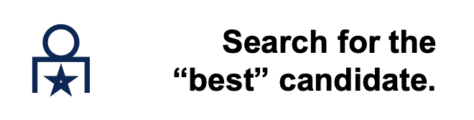

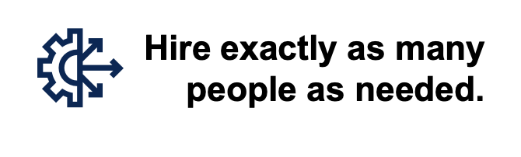

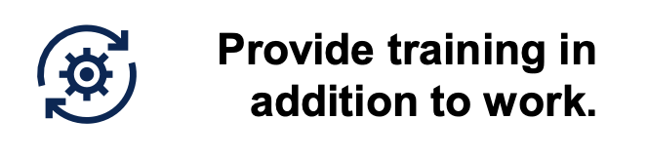

TALENT “PATCHING” – A TYPICAL TALENT APPROACH
Fill specific open positions
Just-in-time hiring
Training “the right” technical specialists
Search the “best” candidate
Hire exactly as many people as needed
Provide training in addition to work

Slide 11

TALENT “PATCHING” – Falls Short
Diverts attention to near-term needs.
Leaves gaps until filled.
Escalates salaries within narrow talent pools.
Increases time to hire.
Limits organizational agility.
Creates key-person dependency and burnout.
Deprioritizes learning in favor of “doing work.”
Detaches learning from its application.

Slide 12
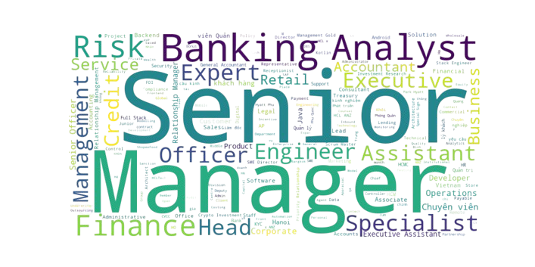
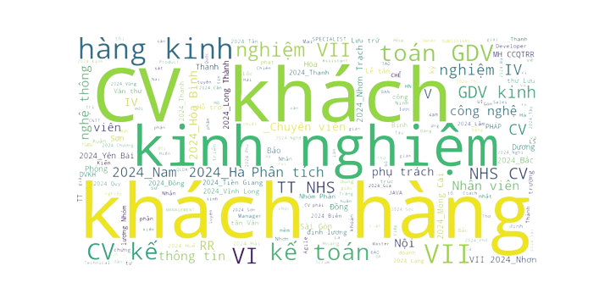
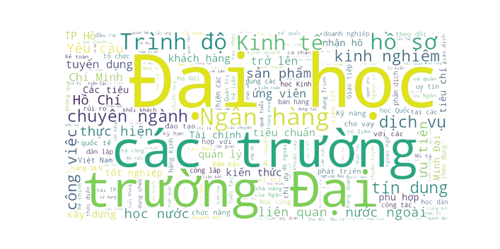
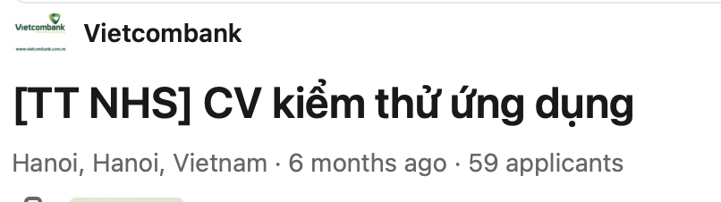
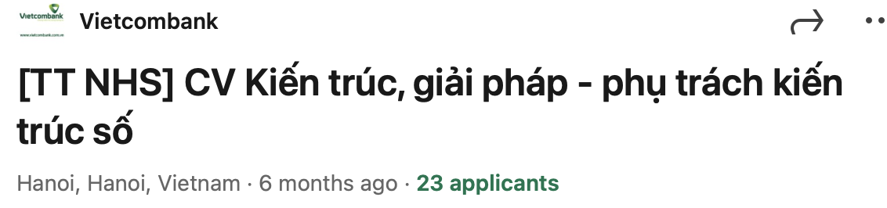
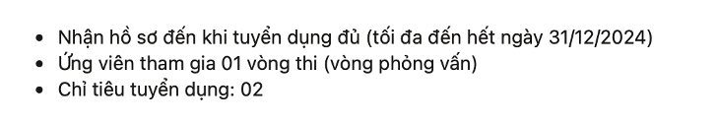
Just need “the best of the best”
Vietnamese-based job descriptions
_______________________
__________________
_________
Weak strategy to attract IT applicants
______
Low recruitment demands for few roles
__________

Slide 13
SOLUTION 1: ADAPTIVE HIRING

Slide 14
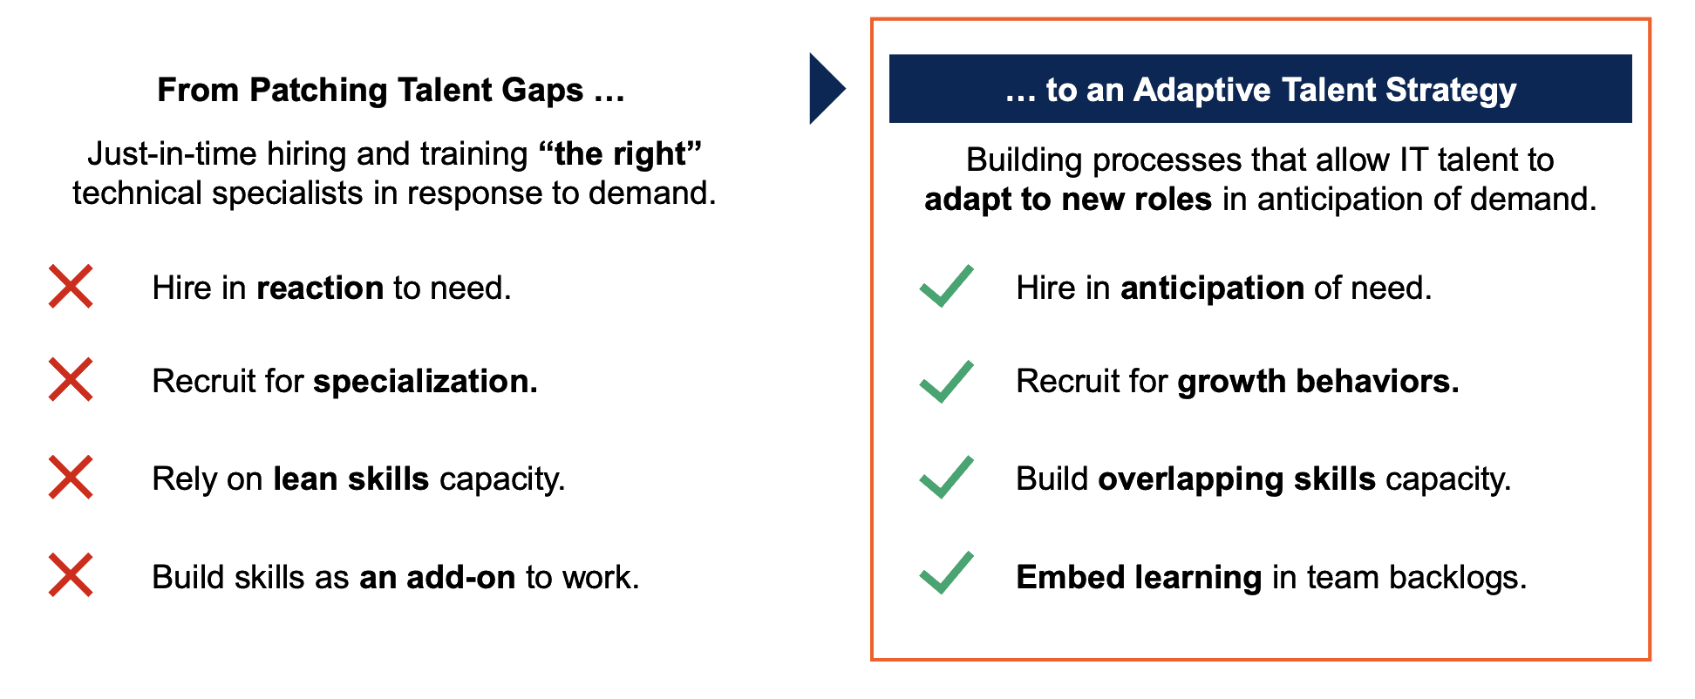
FROM REACTIVE TO ADAPTIVE

Slide 15
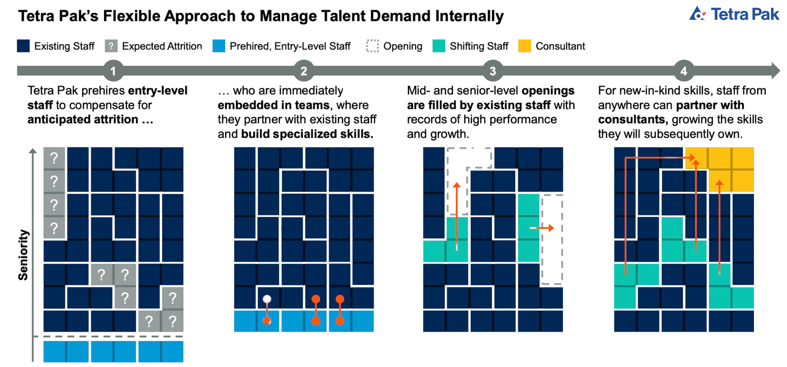
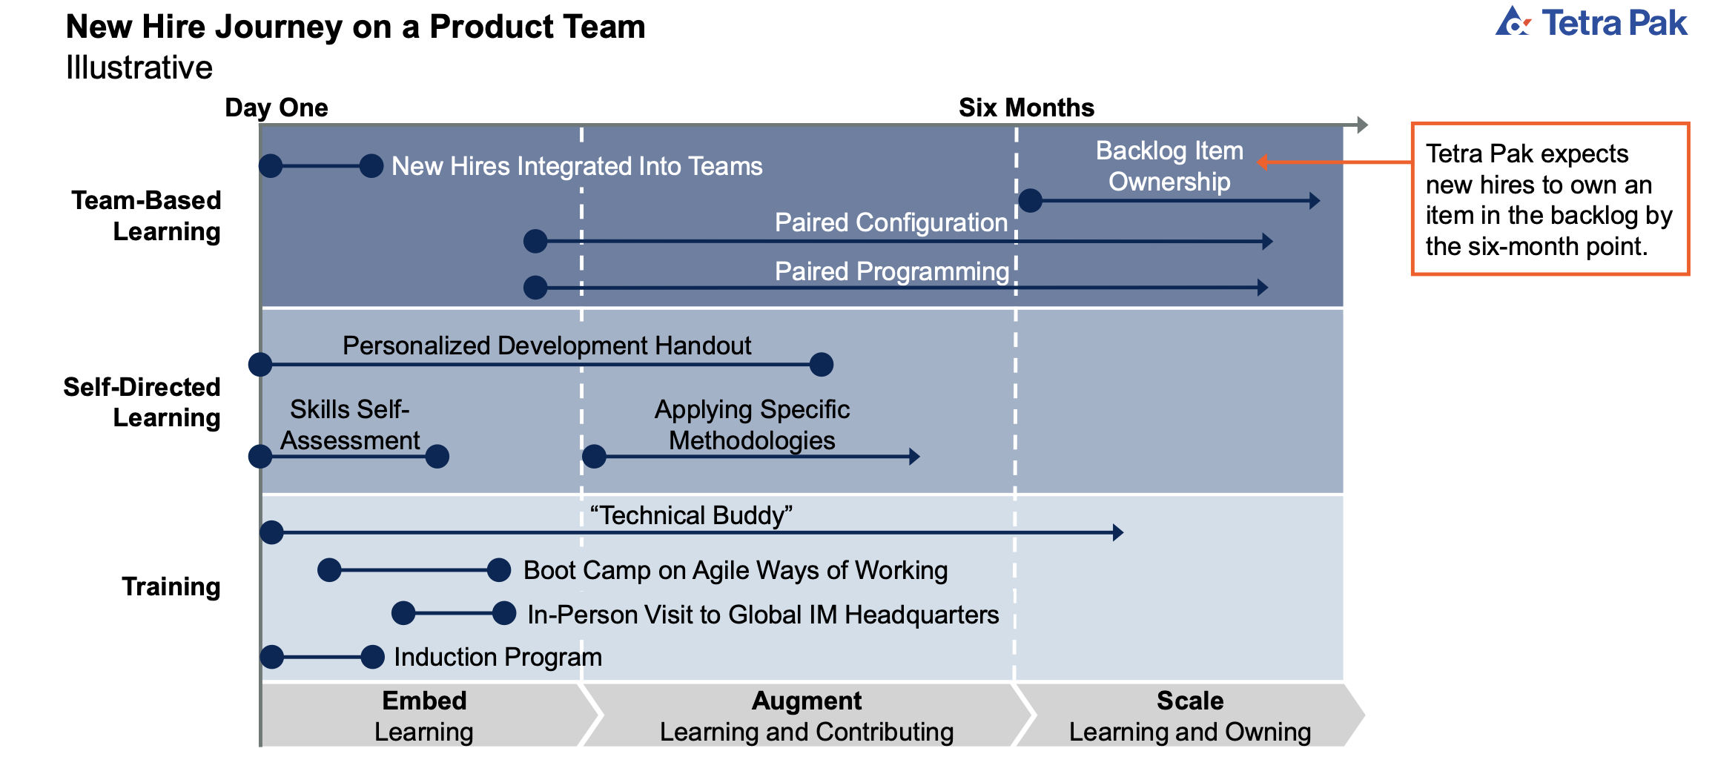
EXAMPLE – TETRA PAK
“Pre-hiring in Batch”
“Embed Learning Into Ways of Working”
Source: Adapted From Tetra Pak

Slide 16
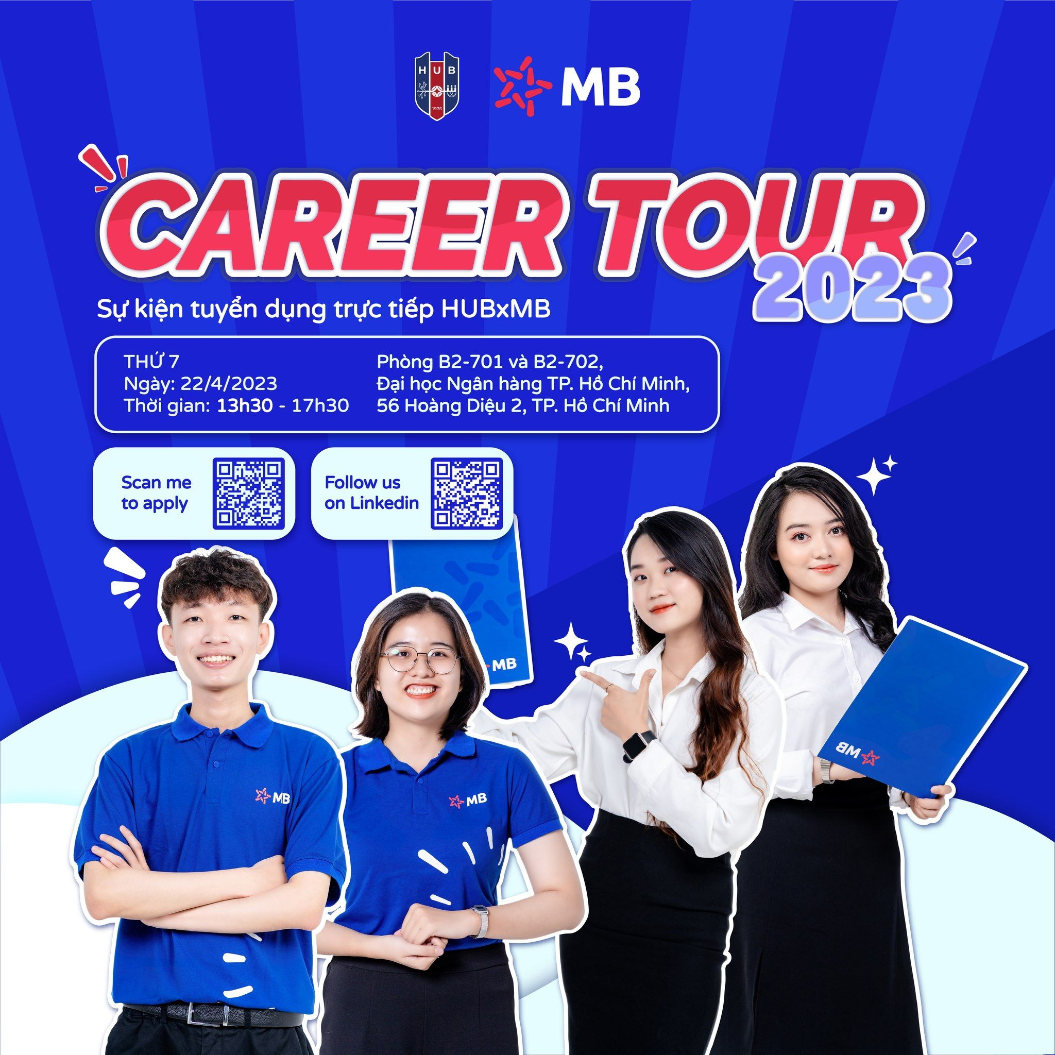
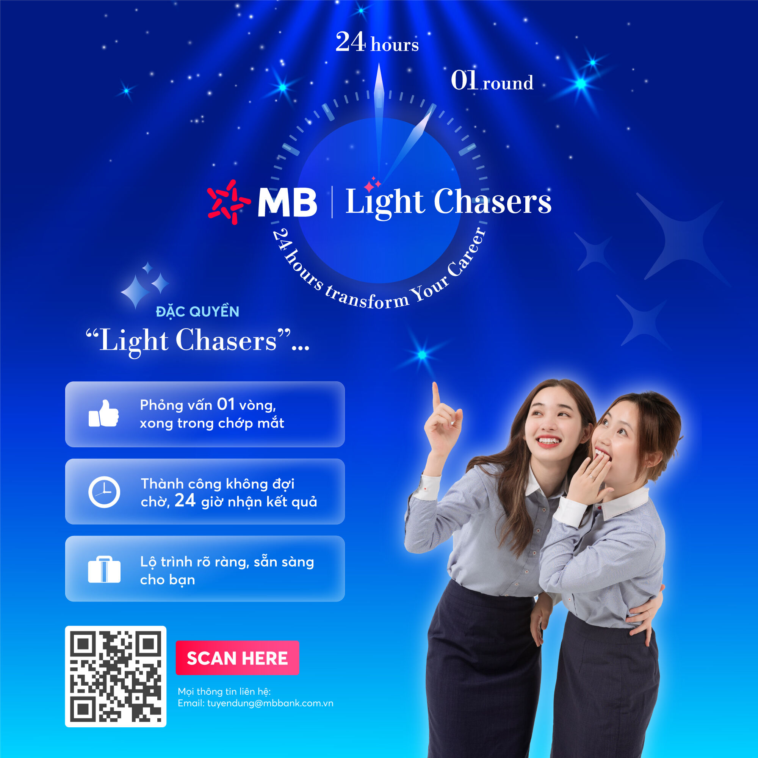
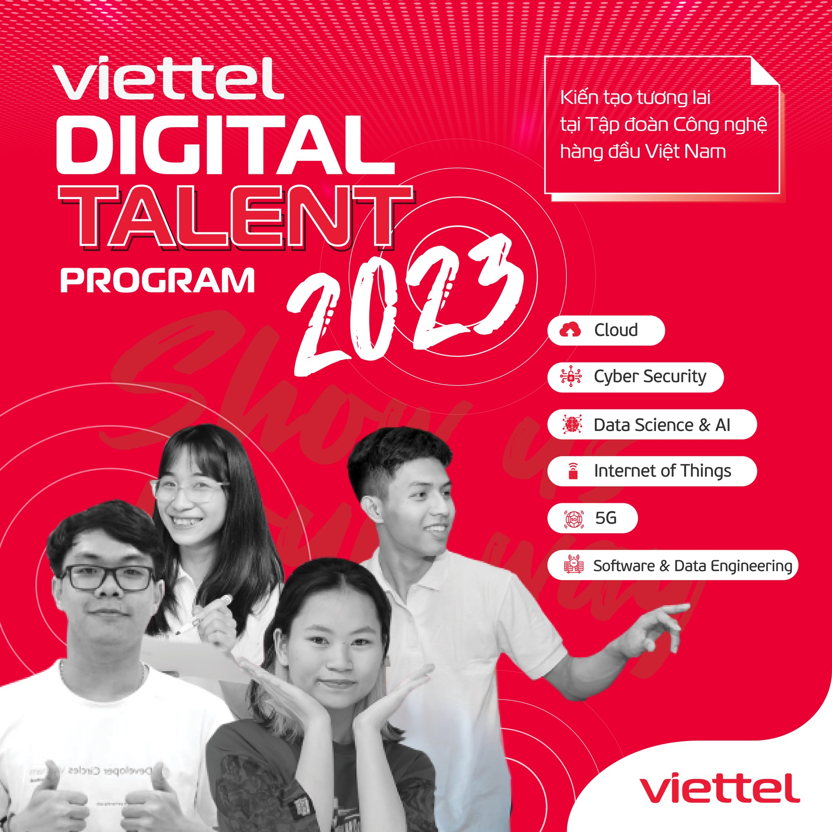
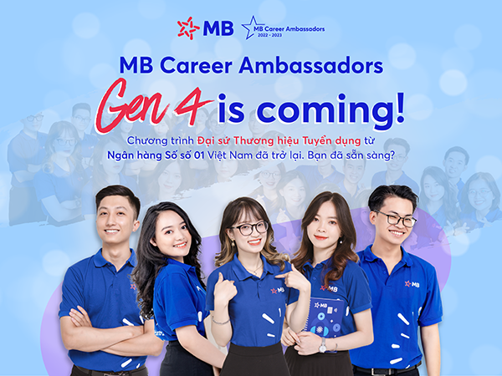
VIETNAM’S ADAPTIVE HIRING TREND

Slide 17
Viettel Digital Talent is a high-tech internship program aimed at nurturing young professionals

Slide 18
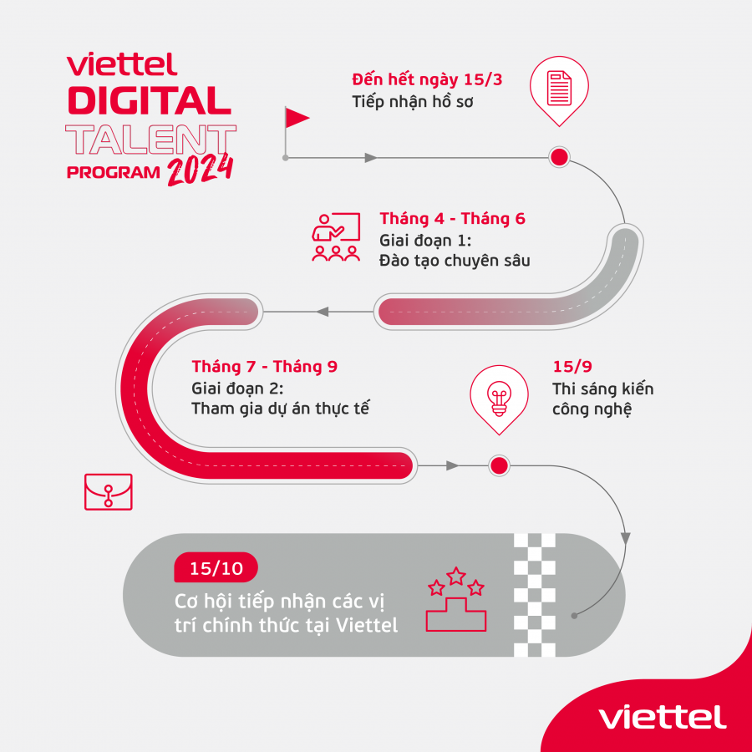
They provide a clear roadmap, integrating learning with working, creating an opportunity not only to become a part of the company but also to shape their career path.
In six months, Viettel Digital Talent offers students the opportunity to experience a training program designed by top experts both domestically and internationally, with extensive experience. Viettel Digital Talent serves as a platform for young talents to push their limits and develop professional skills.
25

Slide 19
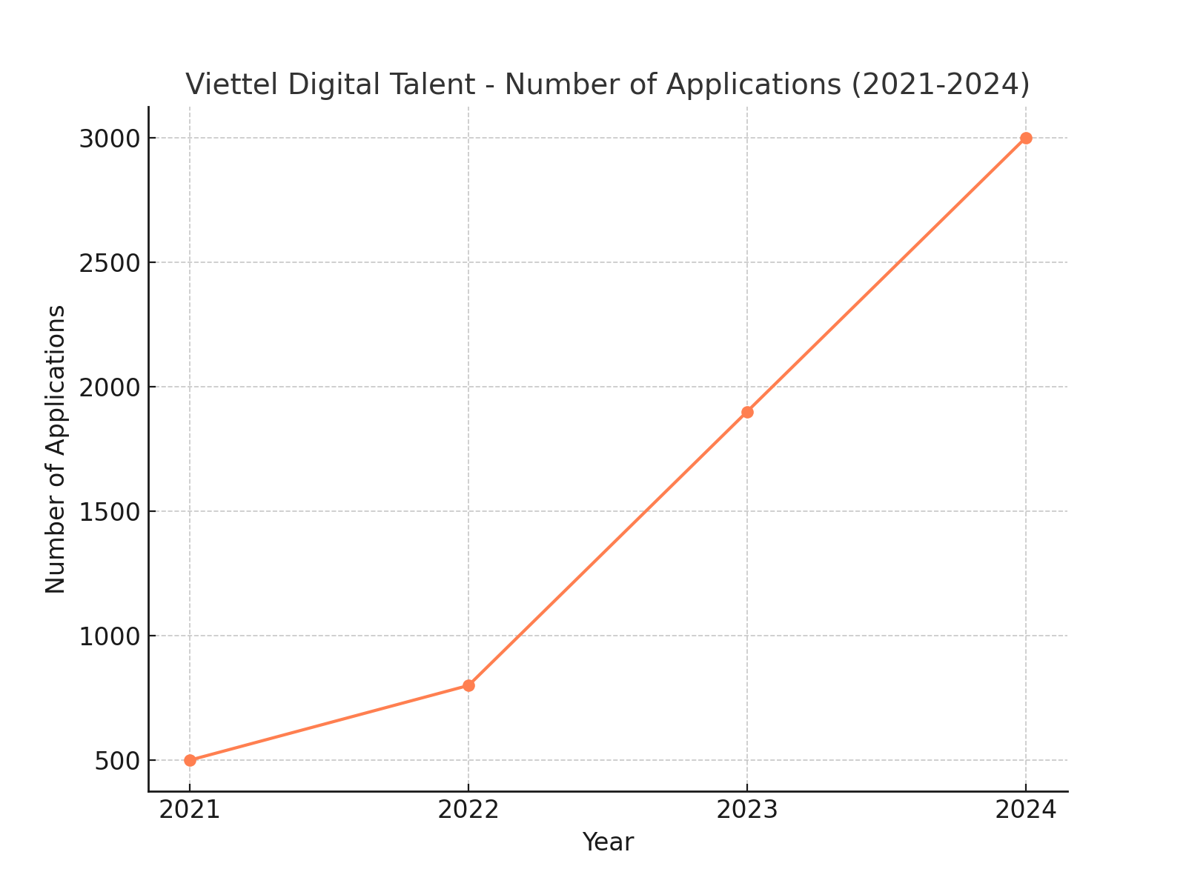
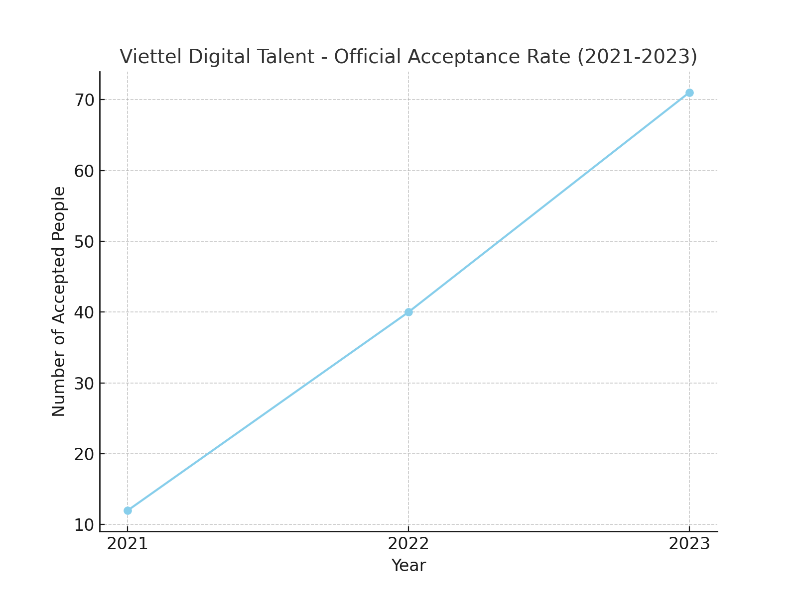
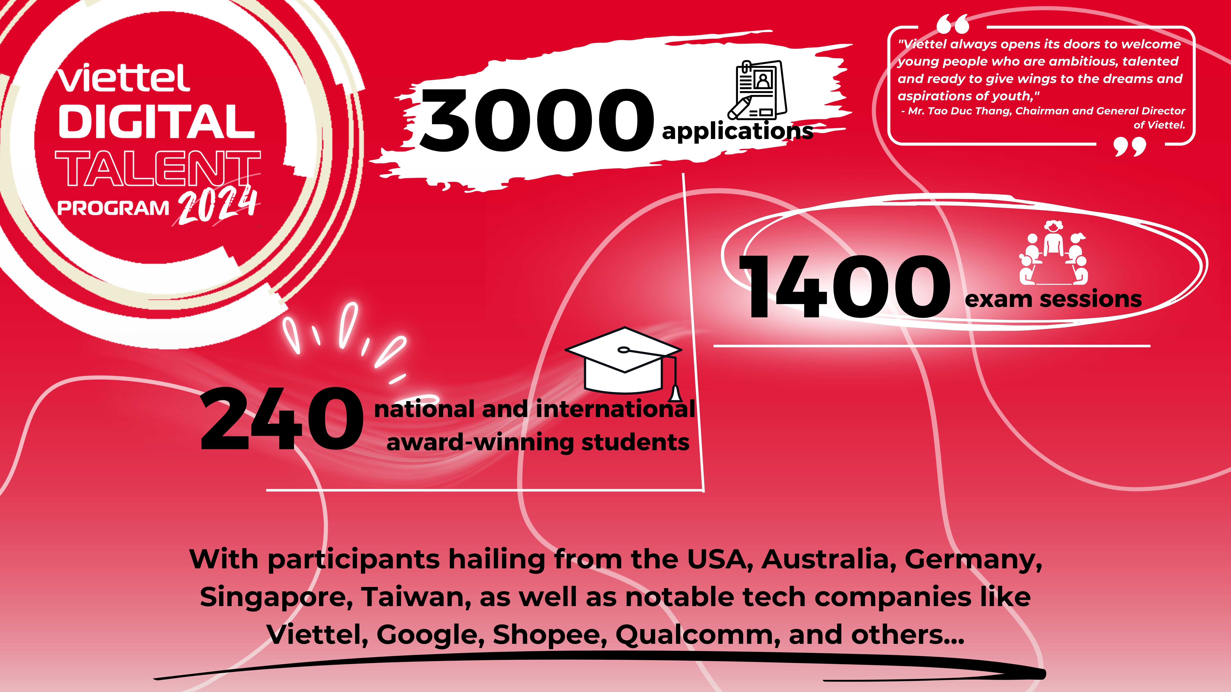
In 2023, the third season of the Viettel Digital Talent program received over 1,900 applications, doubling the number from 2022. Participants went through three training phases, including 651 hours of intensive training with 122 lecturers from both Vietnam and abroad. The program recognized
94 initiatives and ideas from young talents during their direct involvement in key projects.
The fourth season saw a breakthrough with over 3,000 applications, 1,400 exam sessions, and 240 students winning national and international awards, reinforcing the program’s status as Vietnam’s leading internship in both quality and scale. This year, the program will welcome experts from the USA, Australia, Germany, Singapore, Taiwan, and major tech companies such as Viettel, Google, Shopee, Qualcomm, and more

Slide 20


VIETTEL DIGITAL TALENT
Early Career Hiring
Reaching Youth Talents
Enhancing Employer Branding
Increasing Recruitment Efficiency
Creating More Job Opportunities

Slide 21
SOLUTION 2: TALENT ACQUISITION

Slide 22
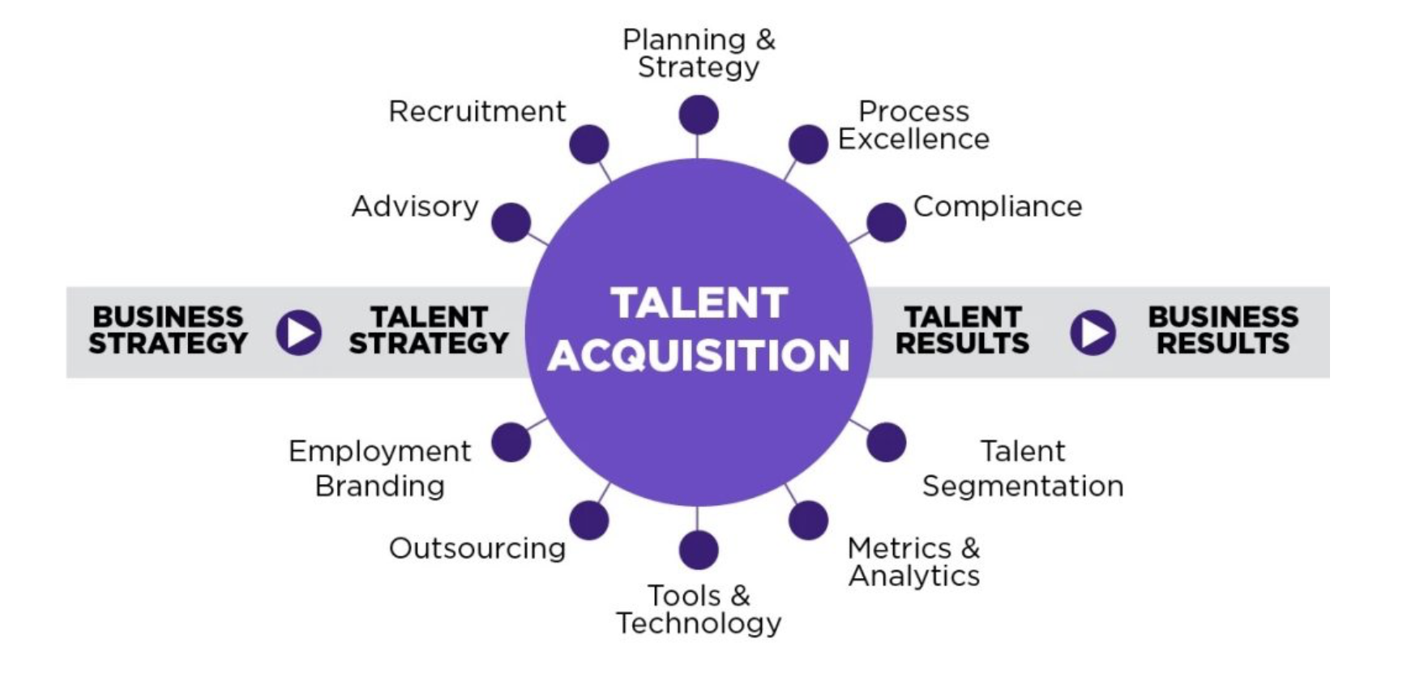
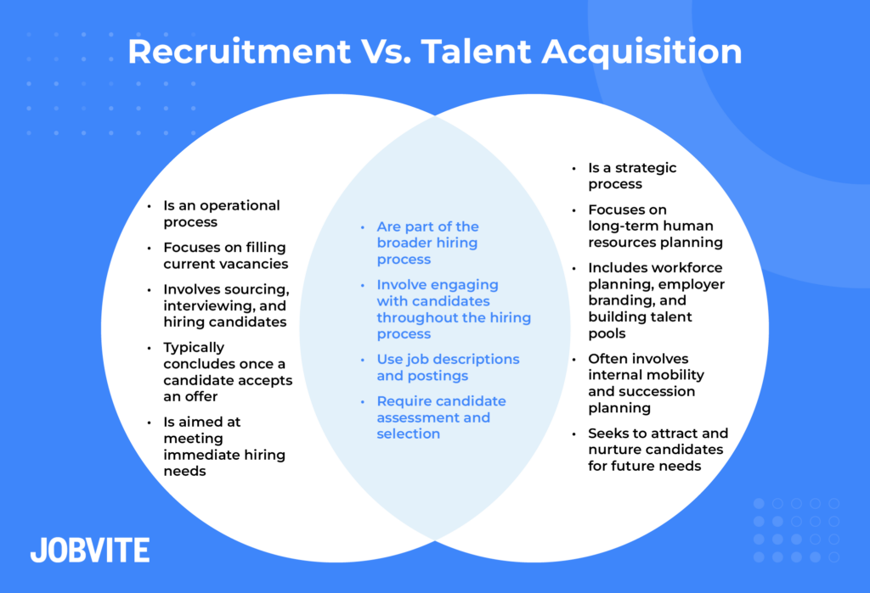
INTRODUCTION – TALENT ACQUISITION
Talent acquisition refers to the process of identifying and acquiring skilled workers to meet your organizational needs.
The talent acquisition team is responsible for identifying, acquiring, assessing, and hiring candidates to fill open positions within a company.
Source: SmartRecruiter
“Talent Acquisition is a strategy to acquire skilled leaders and employes - for a long term success”
“Recruitment is the process of filling positions - which needs to be filled quickly”

Slide 23
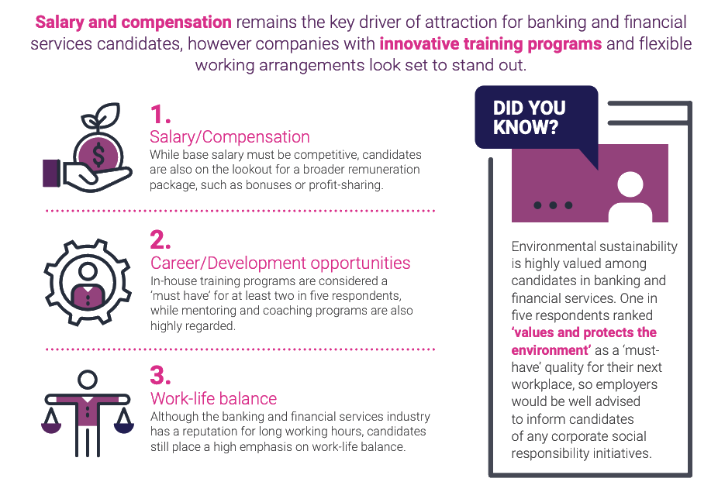
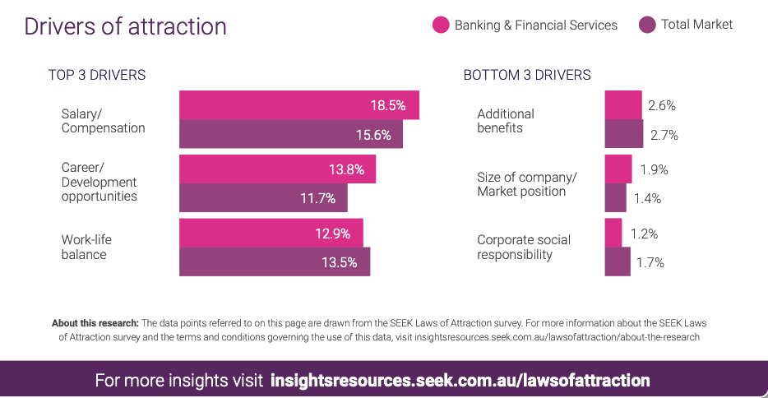
TALENT “FOCUSED”
”The war for talent is never-ending. In my view, there are two principles that organizations should leverage while building a talent strategy.
First, increase the self-sufficiency of internal workforce because we cannot always rely on the external market.
Second, in order to be self-sufficient, it’s important to leverage insights about our talents segments and attract, engage and retain them sustainably by helping them to move up their hierarchy of needs.
- Alexis Pham, CPO, Home Credit Vietnam

Slide 24
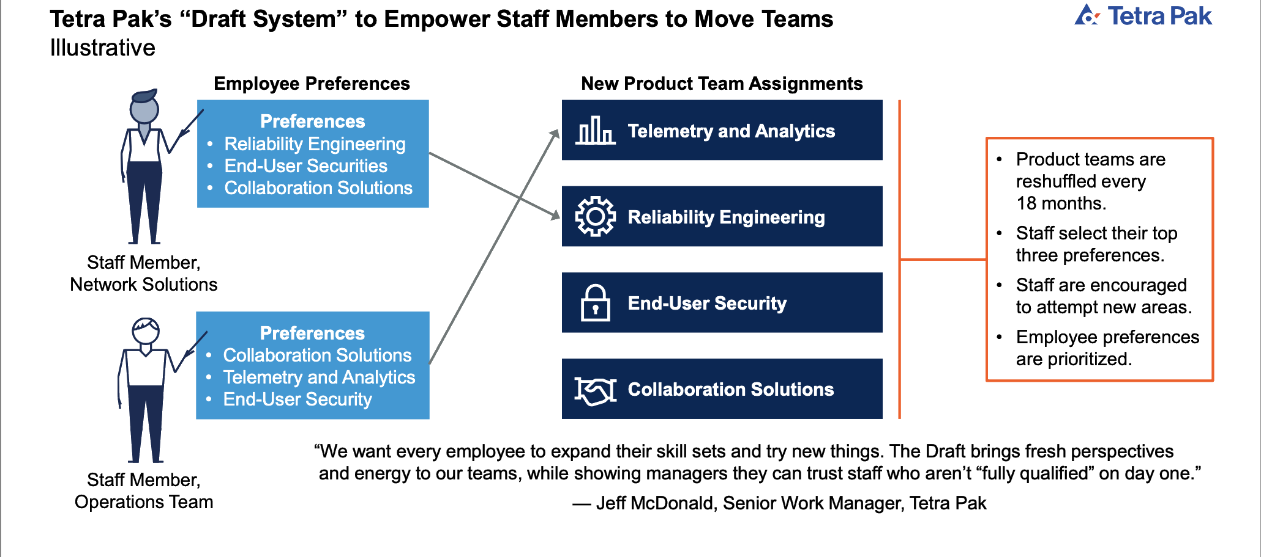
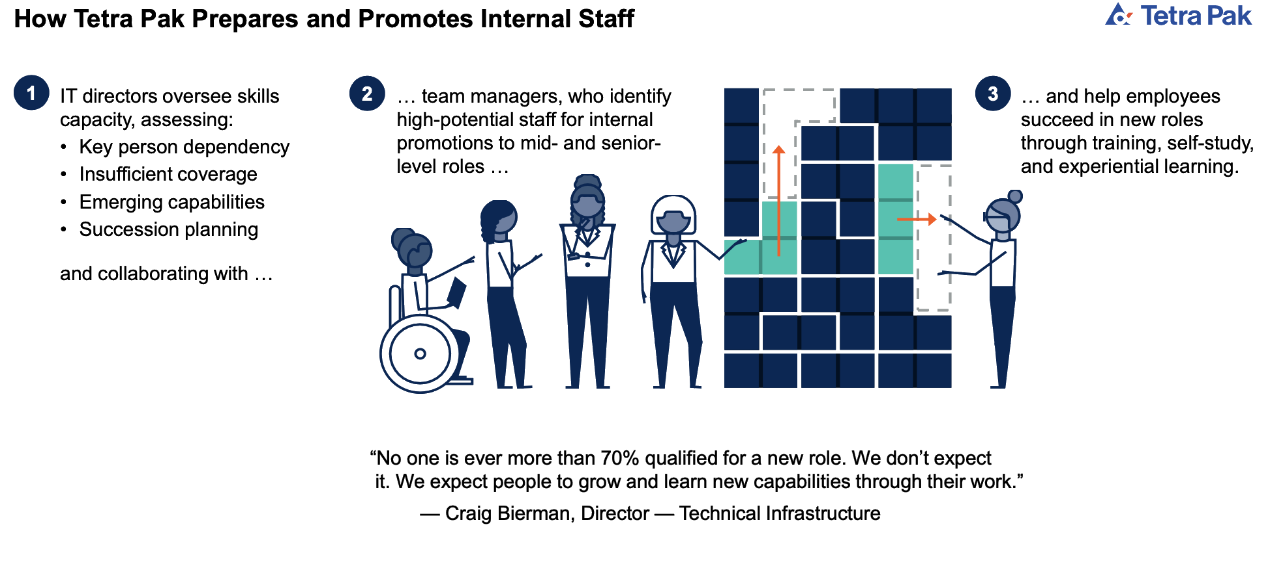
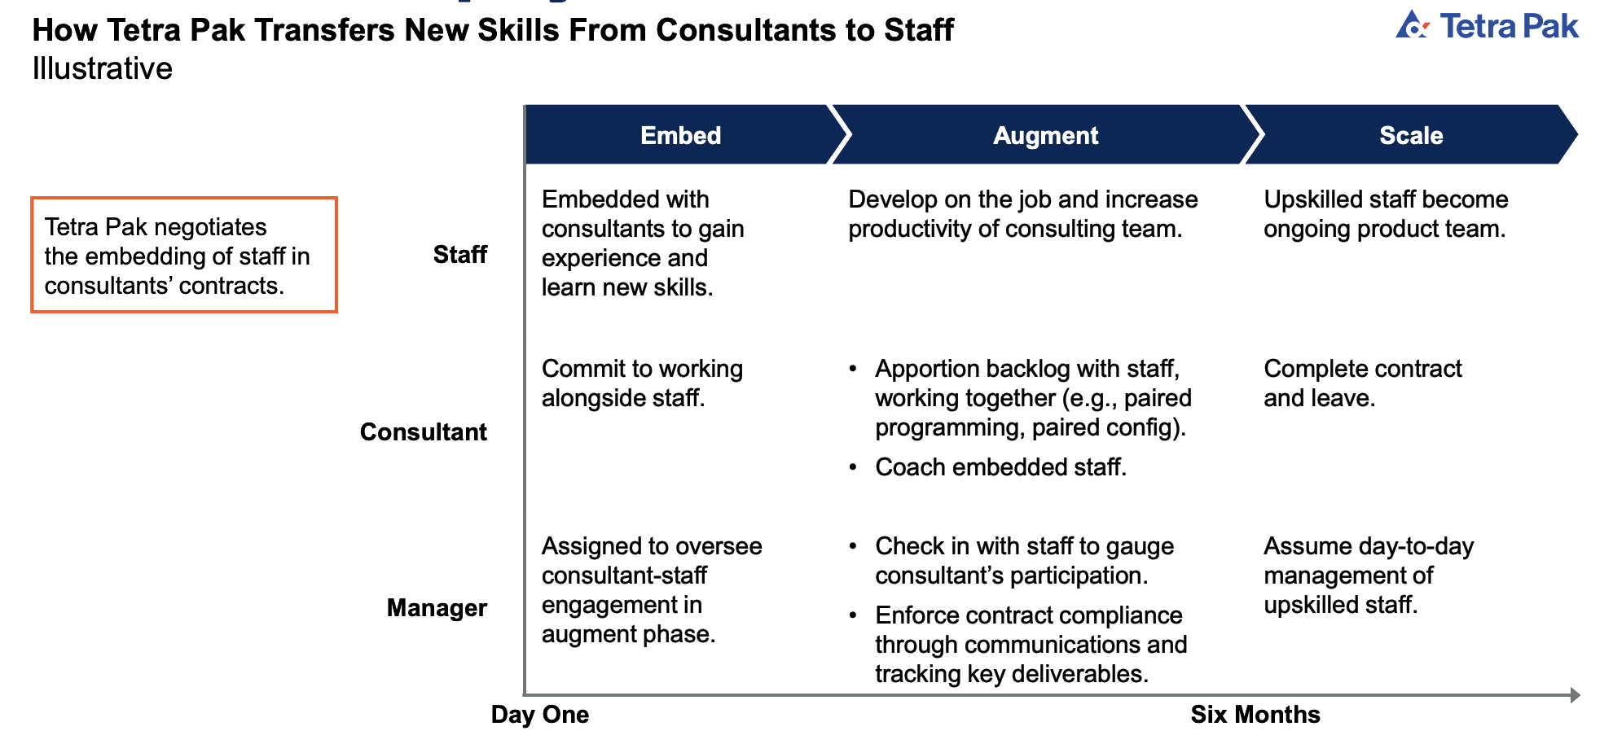
A PLACE TO GROW CAREER
...AND EMPOWER TEAM MANAGERS TO TRUST THEM
_______________________________
________________
_______________________________
________________
Source: Adapted From Tetra Pak

Slide 25
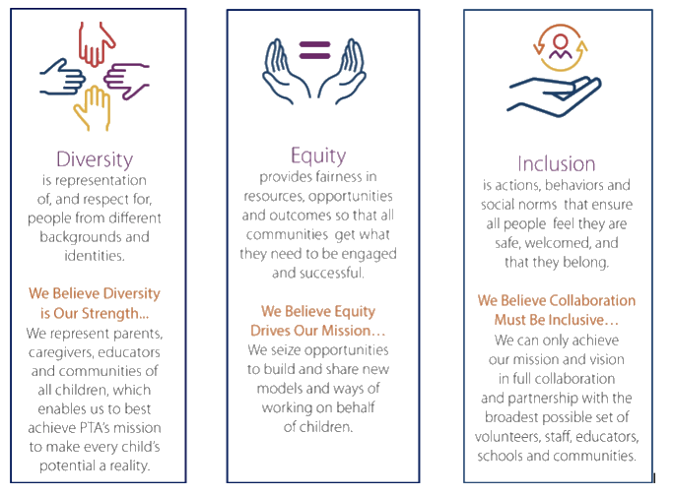
D(Diversity).E(Equity).I(Inclusion)
Diversity, equity, and inclusion (DEI) are organizational frameworks which seek to promote the fair treatment and full participation of all people, particularly groups who have historically been underrepresented or subject to discrimination on the basis of identity or disability
- Wikipedia

Slide 26
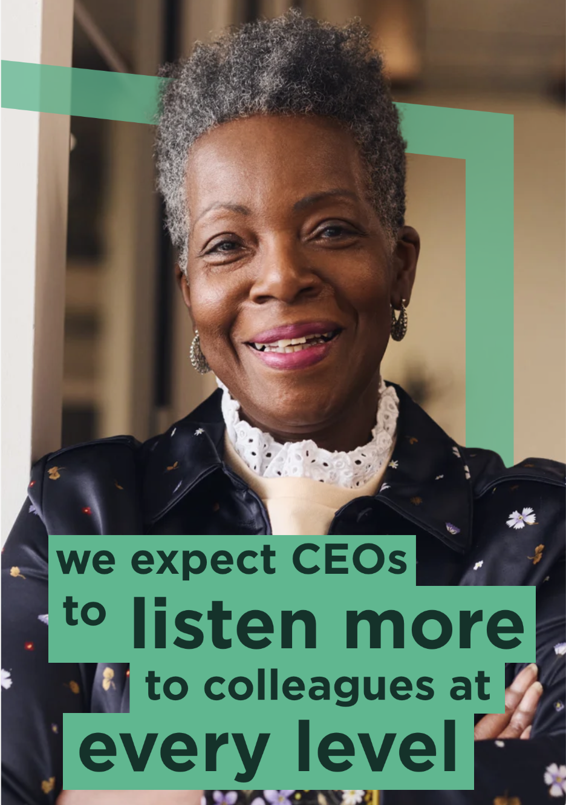
Empathy Regains Importance
Listen up or step down. Empathy regains importance at the top
Are CEOs becoming less empathetic? In a survey of 3,000 HR professionals at the start of 2023, a third said empathy was lacking at the top. And as our own research shows, that’s a big problem for any business that wants to hire and hold onto high performing people. As those high performers move on—taking roles in organizations that give them greater work-life integration, or more freedom to share their opinions without fear, CEOs will have to make changes.
By 2024, we expect CEOs to listen more to colleagues at every level in their business without judgment. That doesn’t mean they’ll stop asking teams to return to the office, but it does mean they’ll think more about the culture they create. And they’ll make more allowances for people’s personal circumstances.
Source: Konn Ferry

Slide 27
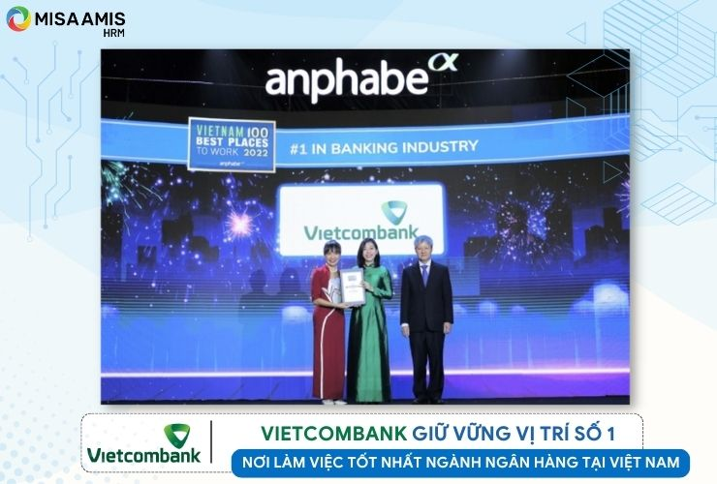
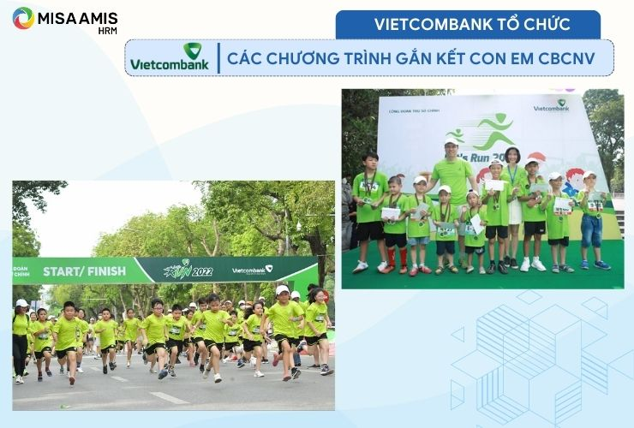
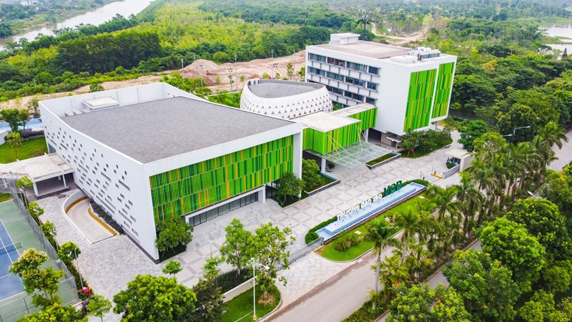
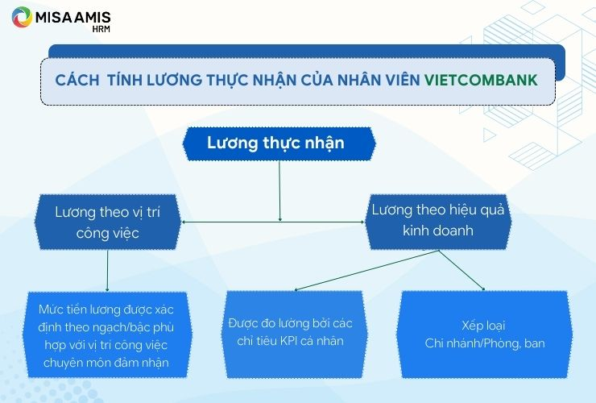
VIETCOMBANK TALENT ACQUISITION
In 2019, each employee at the bank generated VND 1.22 billion in pre-tax profit.
According to actual reports at Vietcombank, the average monthly income per person in 2021 was approximately VND 32.6 million/month (about VND 392 million/year for a total workforce of 21,670 employees). Vietcombank spent over VND 8,500 billion on salaries, bonuses, and allowances for employees at the bank in 2021.
According to the employee satisfaction and engagement survey, recent years have shown outstanding results in the banking sector, with the 2020 score reaching 96.76/100.
Vietcombank has made efforts in attracting talent, enhancing employee experiences, and notably, has received several awards for the best working environment in the banking industry.

Slide 28
BUT
In a survey of 248 responses, Vietcombank employees highlighted the following issues:
Leadership: Through surveys, many employees felt there was a lack of direct and open communication between leadership and staff.
Workload: Currently, the amount of work assigned involves multiple steps, consuming a lot of time. This creates a less friendly working environment, as nearly 90% of the time is spent on completing tasks without much time for communication between employees or with customers.
Employee rotation: Vietcombank does not experience much turnover in relation to changes in business strategy, so staff rotations are limited. Employee rotation is also a way to train staff, providing them with new knowledge and skills. This approach also helps leadership identify the most suitable roles for each of their employees.
Factors affecting work satisfaction of employees at Joint Stock Commercial Bank for Foreign Trade of Vietnam - Binh Duong Branch, Nguyen Dang Quang
Tạo động lực thúc đẩy nhân viên làm việc tại NH TMCP Ngoại thương Việt Nam (Vietcombank) Chi nhánh Thăng Long khoa luan tot nghiep 732, Nguyen Thuy Ngoc
It may be seen as a disadvantage by top tech talent.

Slide 29
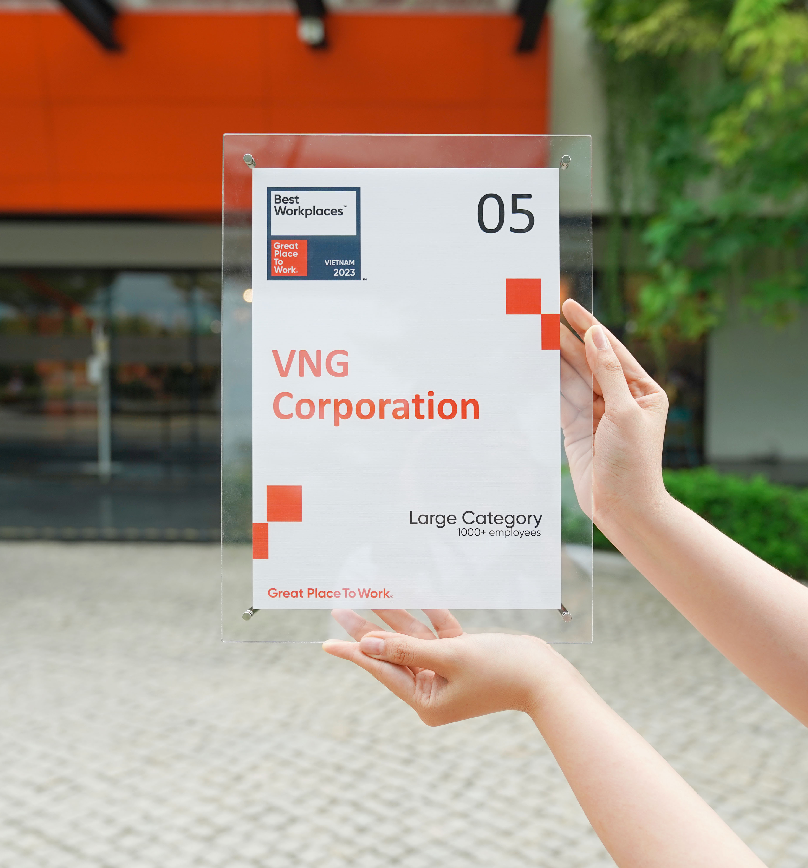
VNG CORPORATION – THE ”GREATEST” PLACE TO WORK

Slide 30
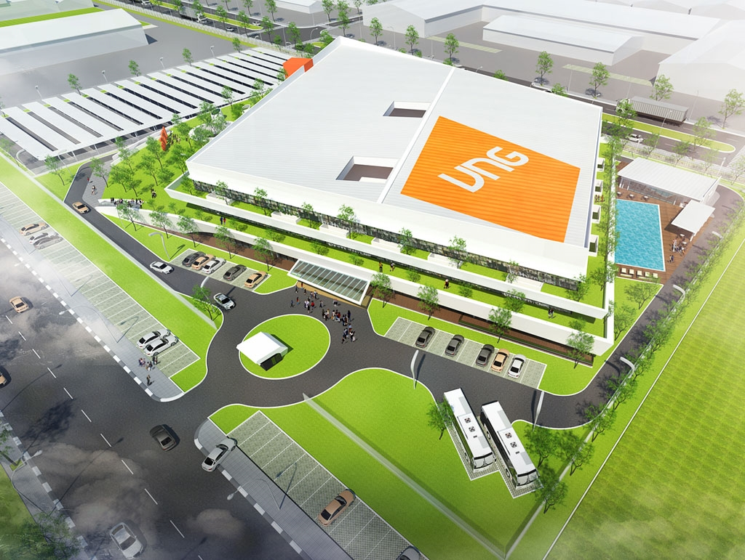
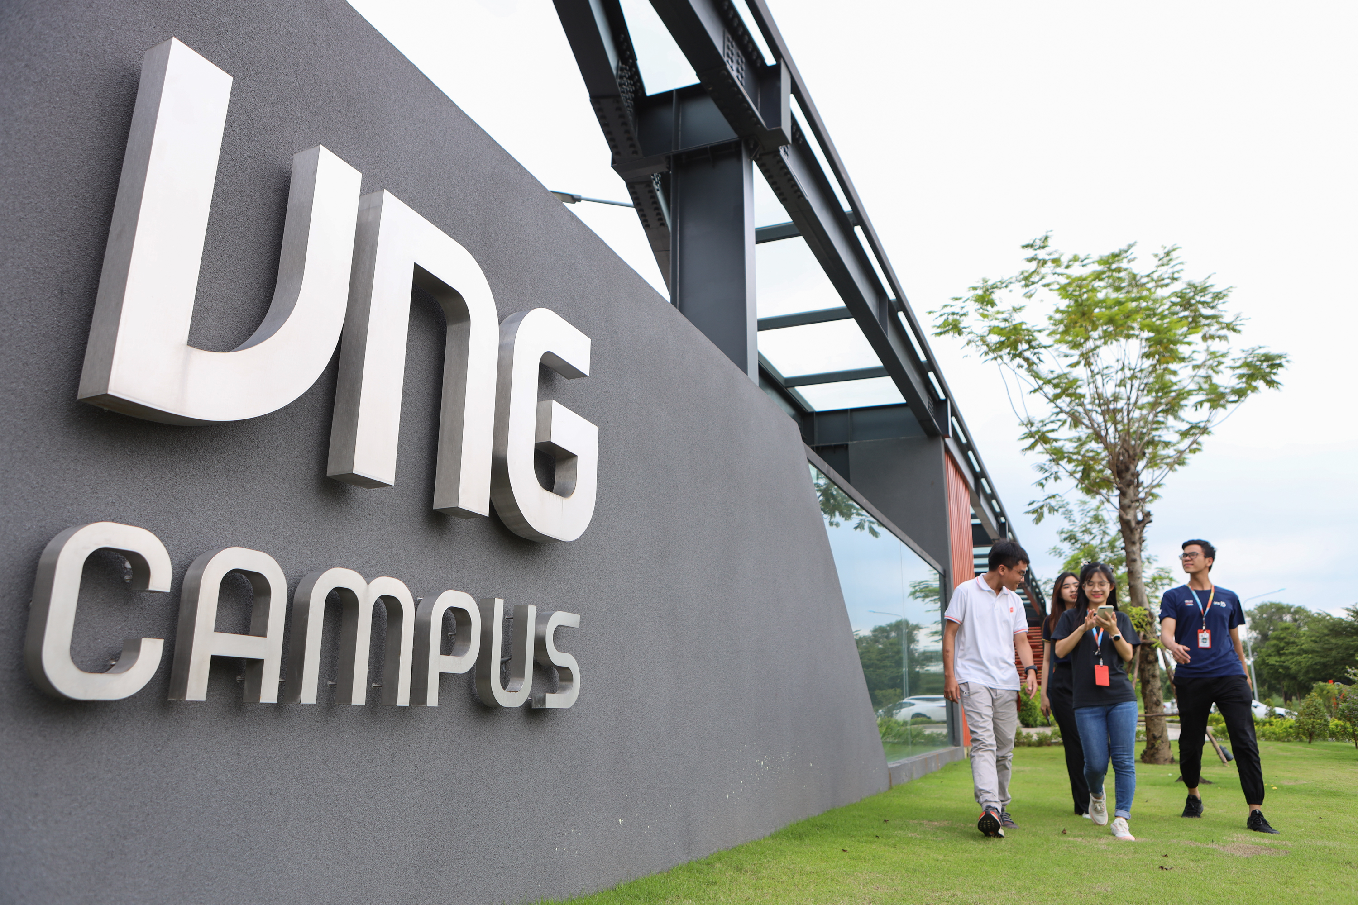
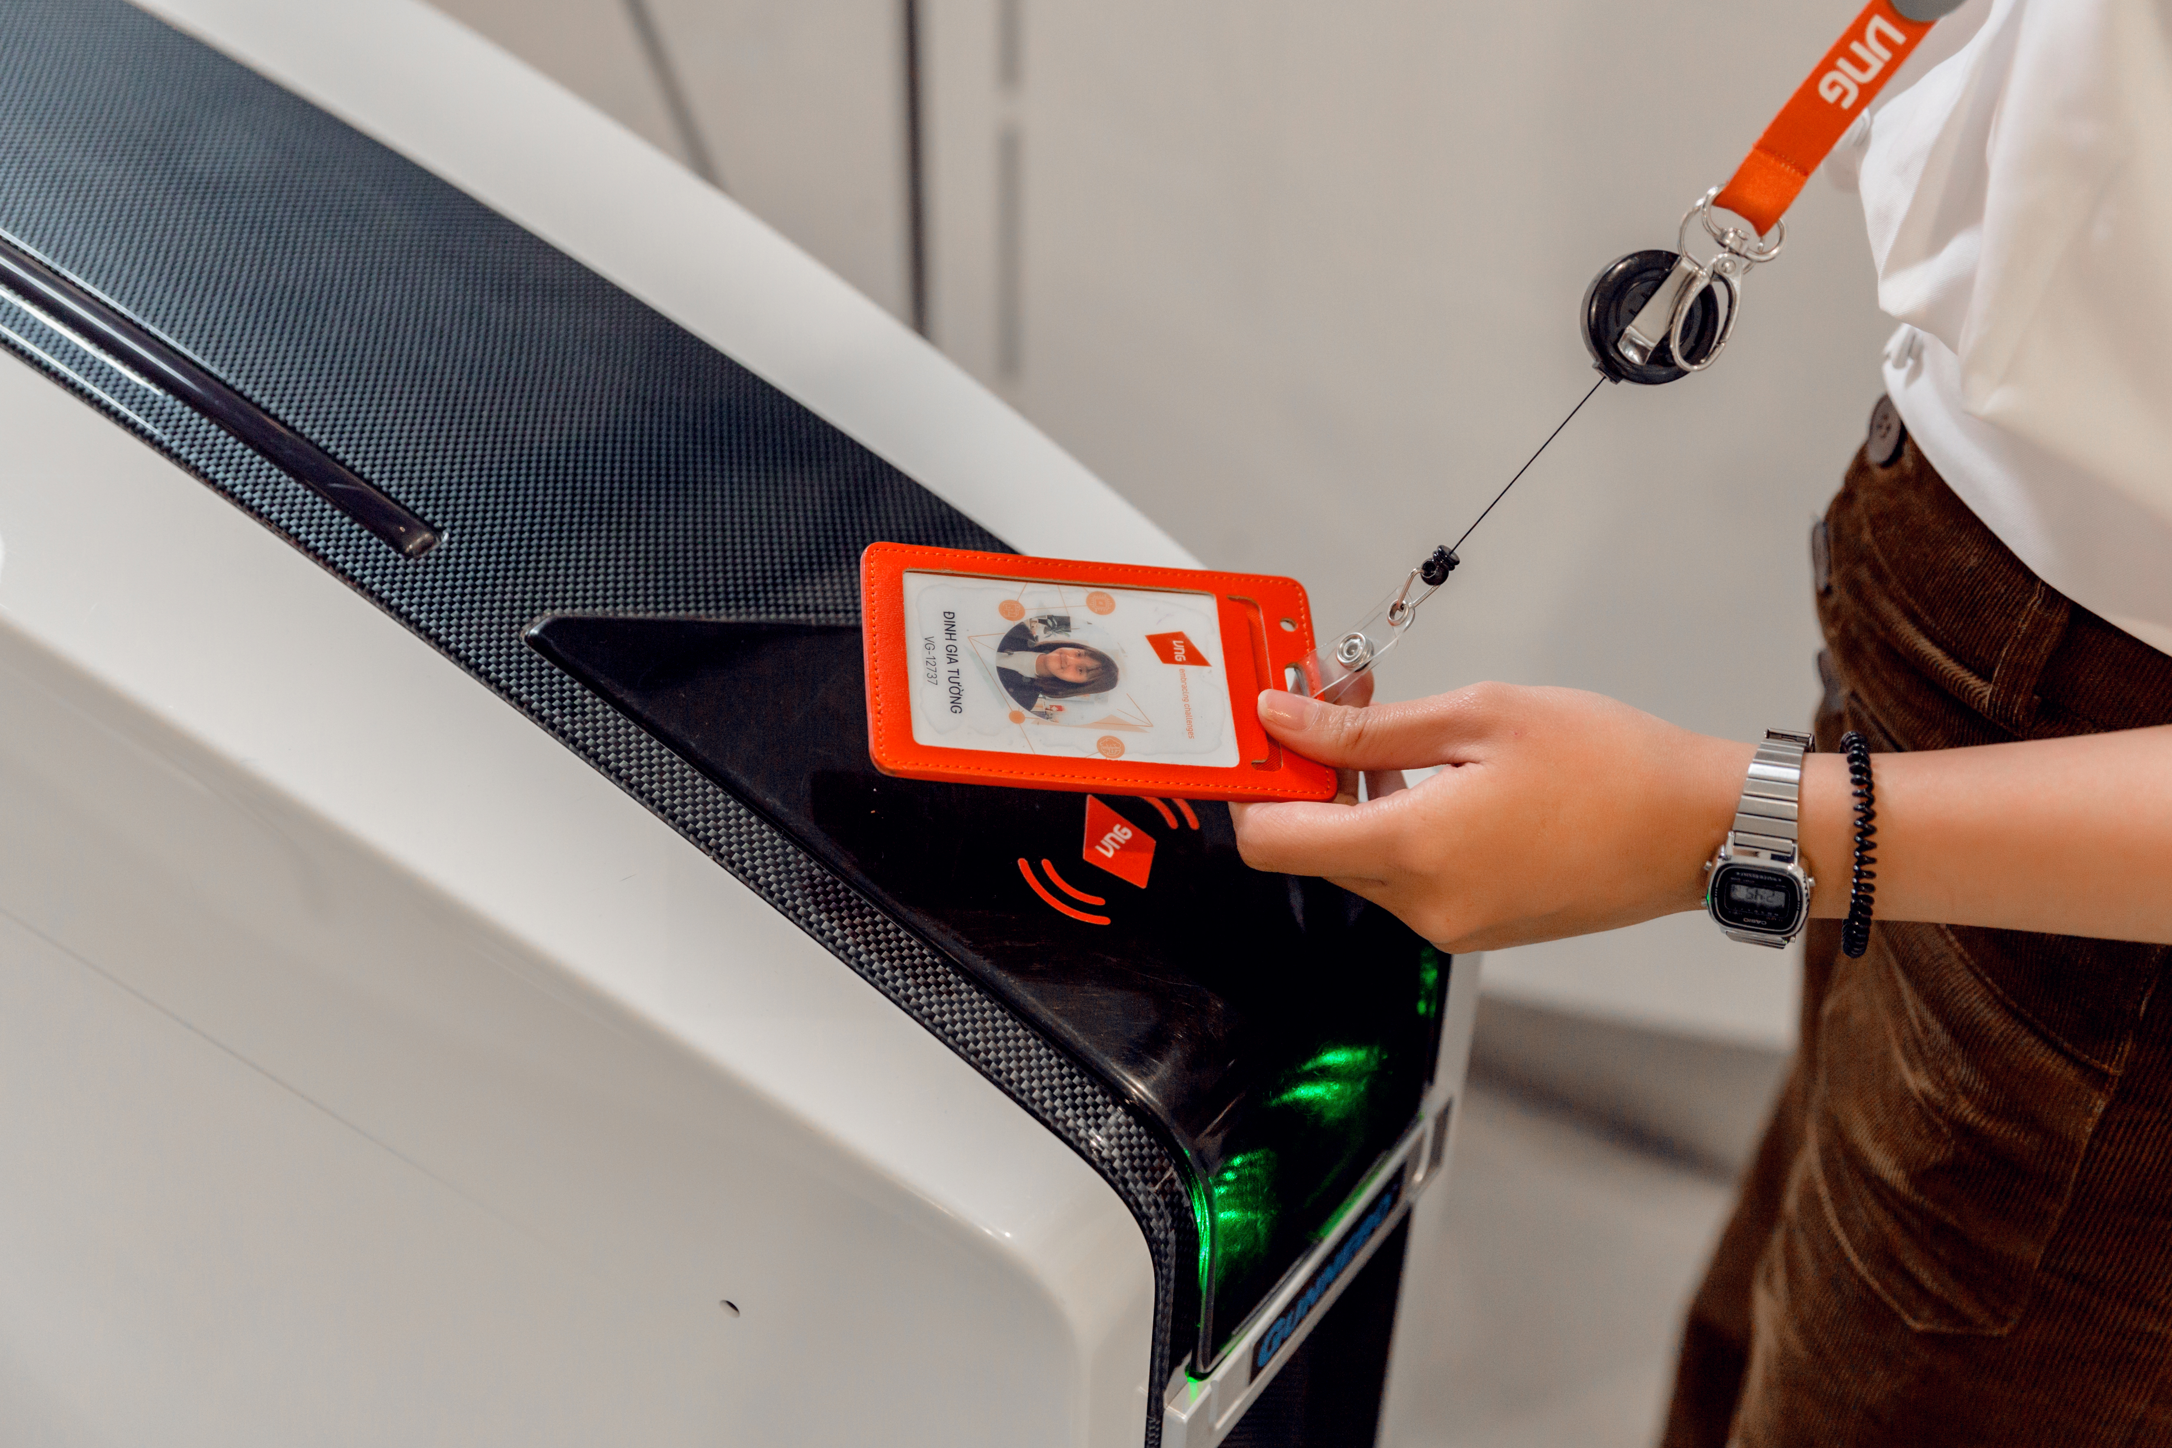

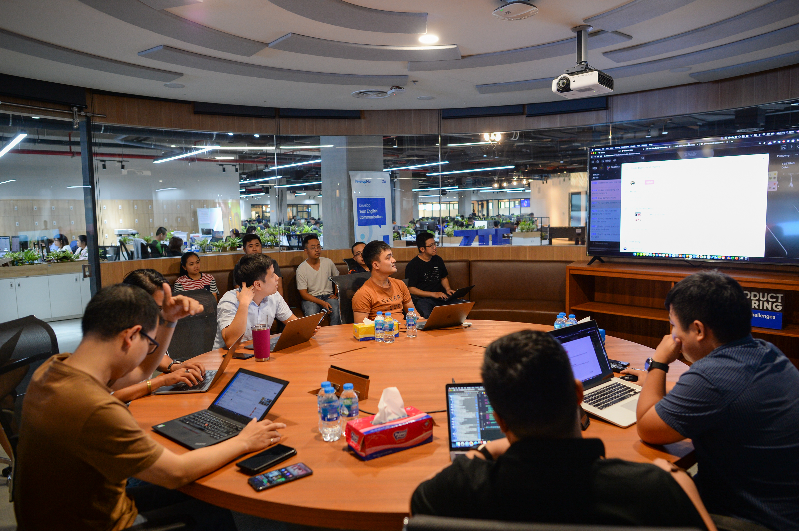



VNG CAMPUS
In addition to the workspace, VNG Campus is designed to promote a healthy work-life balance, focusing on the well-being and happiness of all members (Starters). Inspired by modern office models worldwide, VNG Campus integrates dining areas, relaxation spaces, entertainment, sports facilities, greenery, and scenic landscapes.
39

Slide 31




VNG focuses on developing programs to enhance both professional expertise and soft skills for employees.
VNG Care to Grow: For a generation of employees strong in both mind and body.
Every quarter, VNG Connect is held both in-person and online, providing a platform where VNG leadership updates the business situation, listens to, and addresses the concerns of all employees.

Slide 32



VNG currently has nearly 4,000 employees of almost 20 different nationalities, working across 10 offices worldwide.
Therefore, in 2023, VNG launched VNG Palette, a project that celebrates diversity across generations, industries, and regions, highlighting individual personalities and preferences within the company.

Slide 33


Slide 34

APPENDIX
Adaptive Talent Management: Building a Resilient Workforce for the Future – Neil Osmond.
VNG Campus - VNG Corporation.
A diverse workforce requires inclusive employment practices: Home Credit Vietnam’s Alexis Pham – Shiva ngi Sharma.
Viettel Digital Talent – Viettel Telecom.
Talent Acquisition Trends 2024 – Korn Ferry.

Slide 35

EXECUTIVE SUMMARY

